Slide 1
CS7711 - CREATIVE AND INNOVATIVE PROJECT LOG ANOMALY DETECTION AND CATEGORIZATION
REVIEW 2
Team Members
S.Makesh Narsimhan - 2015103036
G.Krishna Anandan - 2015103596.

Slide 2
INTRODUCTION
Log Detection Thus Far – Manual Techniques
Problems – Scalability , Distributed and Networked Architectures
Solution – Automated Anomaly Detection using DeepLearning and Machine Learning Techniques

Slide 3
PROBLEM DEFINITION
Modern System Requirements –
Availability and Reliability
99% Uptime – System Failures to be rectified in minutes
Points of Failures reflected in Logs – Easy way to pinpoint cause of failure
However, Logs are voluminous and superfluous.

Slide 4
PROBLEM DEFINITION
Automated Log-based Anomaly Detection is Need of the Hour.
Categorizing Logs based on Urgency and Seriousness of issue can streamline maintenance.

Slide 5
LITERATURE SURVEY
# | Title of Paper | Authors | Conference | Methodology | Advantages & Limitations
1. | Evaluating effectiveness of Decision Trees for detection of Code Smells | L. Amorim, E. Costa, N. Antunes, B. Fonseca, and M. Ribeiro | 26th IEEE Transactions on Software Reliability Engineering - 2015 ISSN:1350-1917 | Use of Decision Trees to flag logs as potential errors or not | >75% accuracy achieved. Most easily interpreted supervised ML approach to the problem.
2. | Failure prediction in IBM Bluegene event logs. | Y. Liang, Y. Zhang, H. Xiong, and R. Sahoo | ICDM’07: Proc. of the 7th International Conference on Data Mining, 2007 | Use of Linear and Non Linear SVM ( Support Vector Machines) to anticipate failures. | Linear SVM outperforms Non-Linear SVM model. 70-75% accuracy.

Slide 6
LITERATURE SURVEY
# | Title of Paper | Authors | Conference | Methodology | Advantages
3. | Log clustering based problem identification for online service systems | Q. Lin, H. Zhang, J.G. Lou, Y. Zhang, and X. Chen | ICSE’16: Proc. of the 38th International Conference on Software Engineering, 2016. | Use of unsupervised approaches such as clustering (K-Means) | Practical Approach as most logs lack labels. Used for processing large sets of log data. ~65% accuracy. Heavily susceptible to outliers
4. | Mining invariants from console logs for system problem detection. | J. Lou, Q. Fu, S. Yang, Y Xu, and J. Li | ACM Transactions on Programming and Systems , 2017. ISSN:0164-0925 | Use of Invariant techniques to help identify linear relationships that extend across multiple files. | High accuracy of ~80%. But time consuming for training model.

Slide 7
LITERATURE SURVEY
# | Title of Paper | Authors | Conference | Methodology | Advantages & Limitations
5. | Detecting large-scale system problems by mining console logs | W. Xu, L. Huang, A. Fox, D. Patterson, and M.I. Jordon | Proc. of the ACM Symposium on Operating Systems Principles, 2015 | Use of PCA to help reduce dimensionality of the feature vectors extracted and speeden up the process. | ~60% accuracy. Loss of Informations may deteriorate performance
6. | Experience Report: System Log Analysis for Anomaly Detection | Shilin He, Jieming Zhu, Pinjia He, and Michael R. Lyu | 2016 Elsevier Advances in Software Engineering, ISSN:0965-9978 | Use of Logistic Regression for anomaly detection. | High accuracy of ~80%. Feature Extraction and Selection very tedious. One set of features not compatible for other systems.

Slide 8
LITERATURE SURVEY
# | Title of Paper | Authors | Conference | Methodology | Advantages & Limitations
7. | What Computers Say – Study of Five System Logs | A. Oliner and J. Stearley. | Springer Software Journal on Dependable Systems and Networks, 2007. | Use of Shallow Neural Networks to help understand and predict anomalies in logs | ~60% accuracy. Long term dependencies not mapped.
8. | Industry prac- tices and event logging: assessment of a critical software development process. | A. Pecchia, M. Cinque, G. Carrozza, and D. Cotroneo. | ICSE’15: Proc. of the 37th International Conference on Software Engineering | Use of Data Mining (Association Rule Mining) techniques for anomaly detection. | ~65% accuracy Accuracy outside trained sets rapidly deteriorates.

Slide 9
SURVEY ISSUES LEADING TO THE STATEMENT
Supervised and Unsupervised Methods (Shallow NNs) have been used for Log-based Anomaly Detection..
Limitations of the approaches:
Limited Dependency Lookahead
Models based on one system cannot be used for another
Highly susceptible to outliers
Real-time detection is proving to be difficult.

Slide 10
SURVEY ISSUES LEADING TO THE STATEMENT
We propose to use a DeepLearning Architecture – LSTM (Long-Short Term Memory) Neural Networks to work on this problem.
Log Domains we propose to use:
Power Consumption
Machine/Processor Temperature
In addition, we propose to cluster anomalies based on the impact it might have on the system. (Low, Moderate, High)

Slide 11
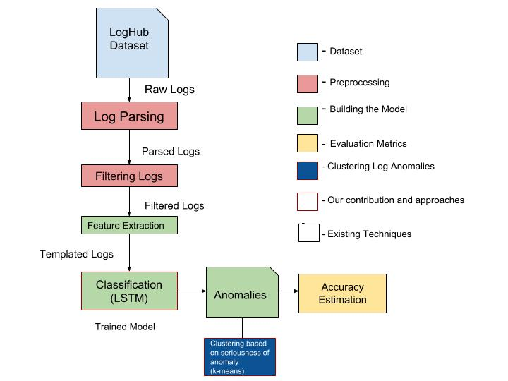
HIGH LEVEL BLOCK DIAGRAM

Slide 13
MODULES
MODULE 1 – SCRAPPING LOGS:-
·INPUT : API Key for LogHub
OUTPUT : Scrapped Logs of various OS and Distributed Systems
Pseudocode:
bool verifyAPIKey( API PublicKey);
List GetLogs (API PublicKey)
{
if(verify(PublicKey)) { scrapLogs(); }
}

Slide 14
MODULES
MODULE 2 - PARSING LOGS:-
·INPUT : The Collection of Logs given as Input to the tool from LogHub
OUTPUT : Template of Log files.
METHODOLOGY : Clustering based(Based on Similarity) or Heuristic Based(Based on Frequency of words).

Slide 15
Pseudocode:
Set makeTermPairs(Log scrappedLogs)
{
String regex1 = “[0-9].*[a-z]*”;
String regex2 = “[0-9].*[a-z]*”;
.
.
String regexn = “[0-9].*[a-z]*”;
for(logs in scrappedLogs)
{
for(regex in regexs)
{
if regex.match(log)
{
addLogLinetoFile;
}
}
}

Slide 16
MODULES
MODULE 2:-
Input : Logs from Dataset/Files.
Output : Template of Logs.
Classifying the Logs into subsets
Logs from Loghub
Discard exceptions
Templates of Logs

Slide 17
MODULES
MODULE 3- FEATURE EXTRACTION
INPUT : Templates of Logs from Module 1.
OUTPUT : Extracting key components from the sets
METHODOLOGY : Generation of Feature Vectors for each Classification.

Slide 18
Pseudocode:
Dict extractFeatures(Log Templates)
{
Dict definition = { logValue , Anomaly };
for(template in Templates)
{
formPair(Value,Anomaly);
}
}

Slide 19

MODULE - 3
Feature Extraction Algorithm
Set of Feature Vectors for the logsets.
Classified Templates
of Logs

Slide 20
MODULES
MODULE 4 – ANOMALY DETECTION OF LOGS USING LSTM
INPUT : Feature Vectors of LogSets
OUTPUT : Detected Anomalies
METHODOLOGY : Use of LSTMs and DeepLearning Techniques

Slide 21
Pseudocode :
List splitTrainTest(Log FeatureSets)
{
X_train, X_Test , Y_train, Y_Test = splitFeaturesets
}
define SlidingWindow ()
{
Sliding WindowSize = ElbowMethod;
}
trainLSTM(X_train,Y_train);
testLSTM(X_test,Y_test);
Evaluate(Y_Pred,Y_test);

Slide 22
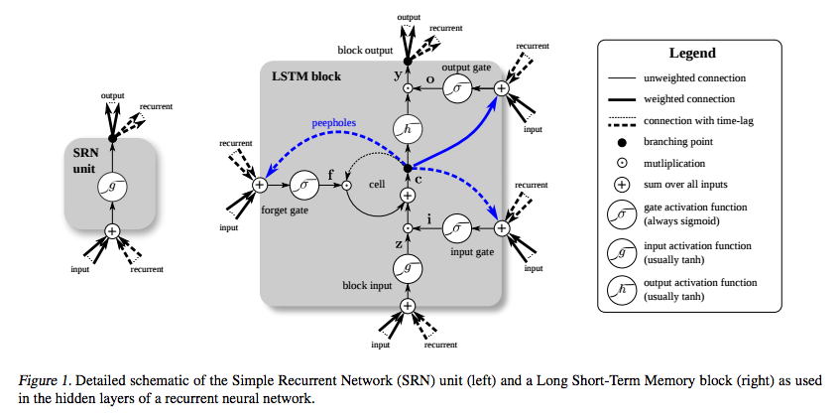
RNN vs LSTM

Slide 23
MODULES
MODULE 4:-
Anamoly Detection Process(LSTM
Feature Vectors
Log Anomalies
Discard Exceptions

Slide 24
MODULES (Contd.)
MODULE 5 - ESTIMATING ACCURACY:-
INPUT - The Conversion Rate of anticipated anomaly and its detection probabilty.
OUTPUT - The Accuracy level of the developed model.
METHODOLOGY – Usage of Precision, Recall and F-Measure.

Slide 25
Pseudocode :
Float precision(data)
{
return #TP/(#TP + #FP);
}
Float Recall (Data)
{
return #TP/(#TP+#FN);
}
Float Fmeasure(Precision,Recall)
{
return 2*( (precision*recall)/(precision+recall));
}

Slide 26
MODULES (Contd.)
MODULE – LOG ANOMALY CLUSTERING :-
INPUT - Predicted Anomalies from LSTM
OUTPUT – Seriousness of the Anomaly (Low, Moderate,High)
METHODOLOGY – K-Means Clustering

Slide 27
ALGORITHM
Clusters the data into k groups where k is predefined.
Select k points at random as cluster centers.
Assign objects to their closest cluster center according to the Euclidean distance function.
Calculate the centroid or mean of all objects in each cluster.
Repeat steps 2, 3 and 4 until the same points are assigned to each cluster in consecutive rounds.

Slide 28
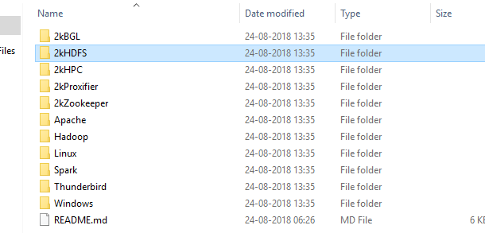

SCREENSHOTS – Module 1
INPUT:
OUTPUT:

Slide 29
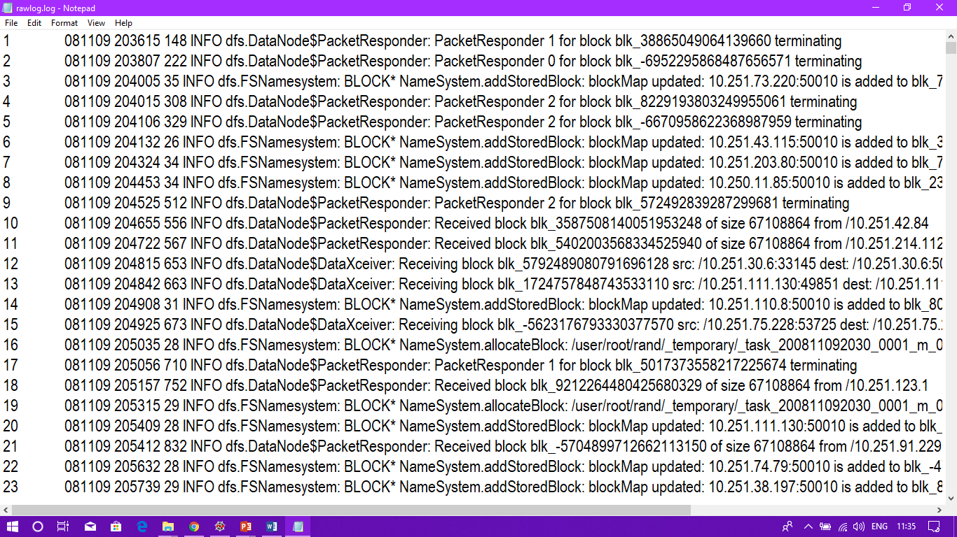
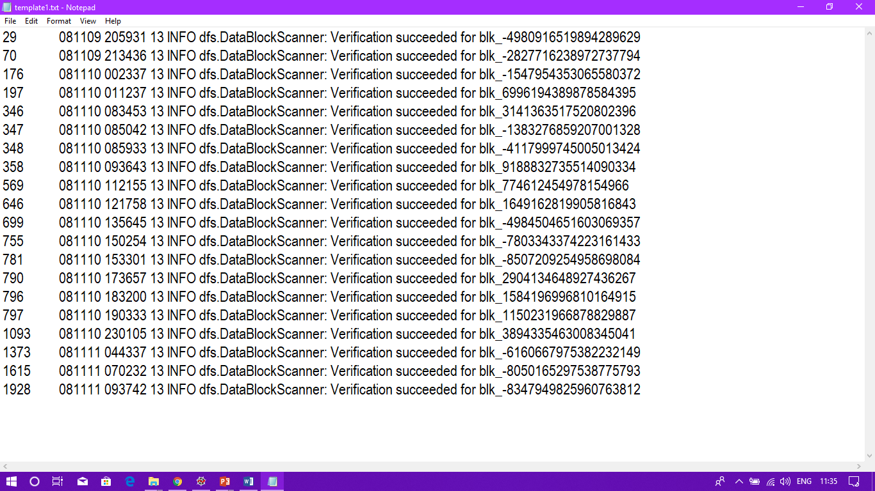
SCREENSHOTS – Module 2
INPUT
OUTPUT

Slide 32


SCREENSHOTS – Module 3

Slide 33
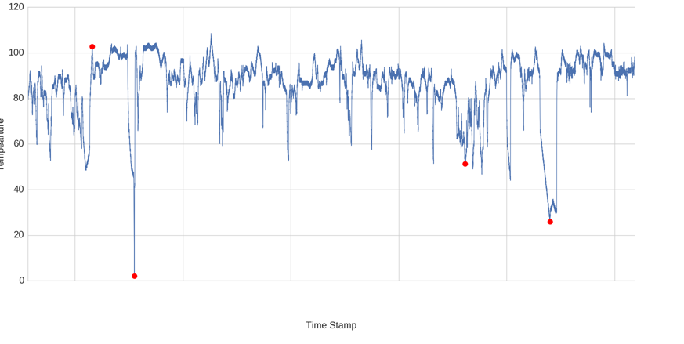
SCREENSHOTS – Module 4

Slide 34
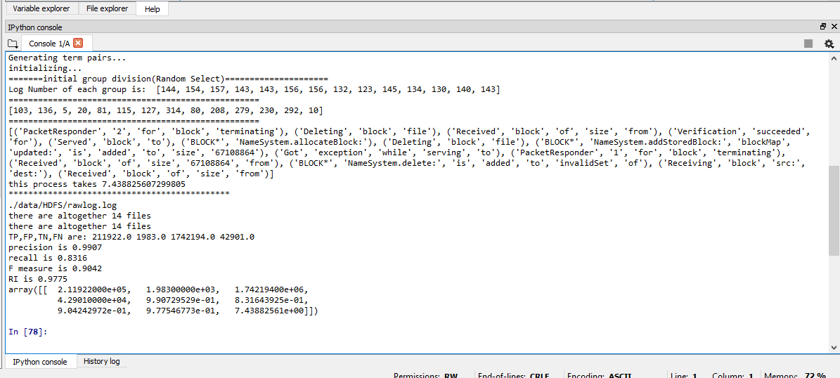
SCREENSHOTS – MODULE 5

Slide 35
Performance and evaluation metrics
The Performance of the Log Parser is evaluated using Precision Recall and F-Measure which showed an accuracy of 93.14%.
The Performance of the LSTM model was evaluated using the Lookback Parameter which was rivalled against Prediction.
The Sum of Squared Errors measure was used to evaluate the K-Means Algorithm.
The graph tapered around 3 and hence 3 clusters was designated as low, medium and high.

Slide 36
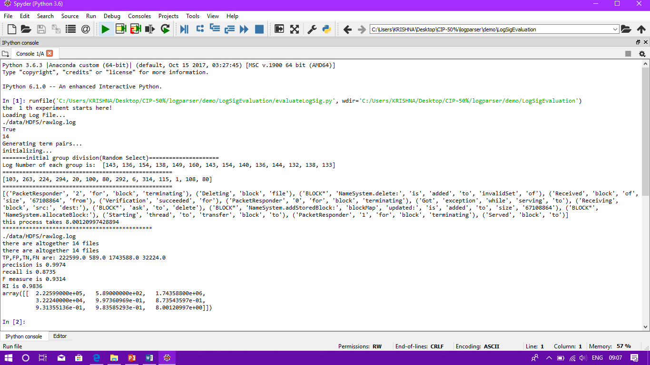
LOG PARSER ACCURACY

Slide 37
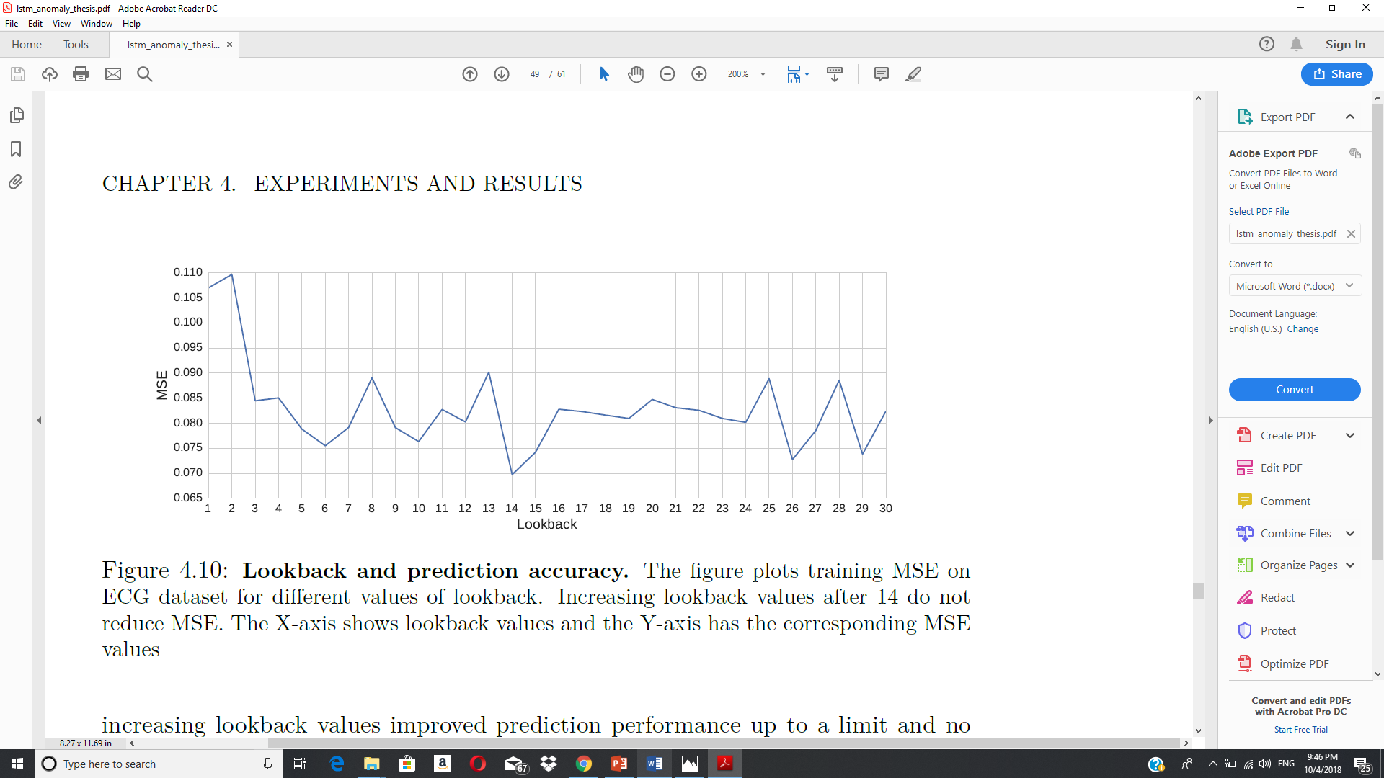
LOOKBACK VS. PREDICTION

Slide 38
ACCURACY MEASUREMENT FOR LSTM
Measure | Train Dataset | Test Dataset
F-Measure | 0.973 | 0.957
Precision | 0.977 | 0.978
Recall | 0.971 | 0.952

Slide 39
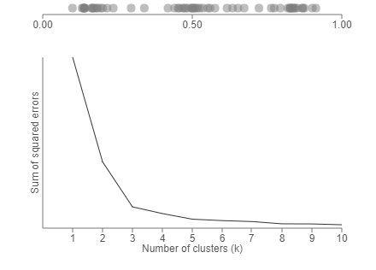
ELBOW MEASURE FOR K-MEANS

Slide 40
REFERENCES
L. Amorim, E. Costa, N. Antunes, B. Fonseca, and M. Ribeiro, “Experience report: Evaluating the effectiveness of decision trees for detecting code smells,” 2015 IEEE 26th International Symposium on Software Reliability Engineering (ISSRE), 2015.
Y. Zhang and A. Sivasubramaniam, “Failure prediction in IBM BlueGene/L event logs,” 2008 IEEE International Symposium on Parallel and Distributed Processing, 2008.
Q. Lin, H. Zhang, J.-G. Lou, Y. Zhang, and X. Chen, “Log clustering based problem identification for online service systems,” Proceedings of the 38th International Conference on Software Engineering Companion - ICSE 16, 2016.
J. Li and J. Cao, “System Problem Detection by Mining Process Model from Console Logs,” Lecture Notes in Computer Science Network and Parallel Computing, pp. 140–144, 2017.
W. Xu, L. Huang, A. Fox, D. Patterson, and M. I. Jordan, “Detecting large-scale system problems by mining console logs,” Proceedings of the ACM SIGOPS 22nd symposium on Operating systems principles - SOSP 09, 2009.

Slide 41
REFERENCES
6. S. He, J. Zhu, P. He, and M. R. Lyu, “Experience Report: System Log Analysis for Anomaly Detection,” 2016 IEEE 27th International Symposium on Software Reliability Engineering (ISSRE), 2016.
7. A. Pecchia, M. Cinque, G. Carrozza, and D. Cotroneo, “Industry Practices and Event Logging: Assessment of a Critical Software Development Process,” 2015 IEEE/ACM 37th IEEE International Conference on Software Engineering, 2015.
8. M. Cheng, Q. Xu, J. Lv, W. Liu, Q. Li, and J. Wang, “MS-LSTM: A multi-scale LSTM model for BGP anomaly detection,” 2016 IEEE 24th International Conference on Network Protocols (ICNP), 2016.

